Slide 1
College tuition, diversity, and pay
Isaac Tabor

Slide 2
Two Main Goals
Provide data-driven college recommendations to students, especially for those they might not have heard of before.
General insights about trends in campus diversity, expected salary, tuition, etc. because collEDGE markets to students on these topics
Notes:
Note: as this task is a bit broader than the rest by nature, feel free to create one or several “case studies” in addition to (or perhaps instead of) your general recommendations, showing what schools you would recommend

Slide 3
Data-driven college recs students may not have heard of
For, this I focused on financial value:
Value Score Column = (10*Early Career Pay) + (30*Mid Career Pay) - (4* Net Cost)
Basically = Post-Grad Earnings over 40 years - How much had to pay to get those earnings
Really simplified but generally captures financial value
Notes:
This is really simplified, you can find flaws with this value score (does not take into account cost relative to their income level for instance or quality of education), but point is it captures some financial value.

Slide 4
Net costs varied depending on income level.
Average Net Cost by Income Level
Income Level | Range | Average Net Cost
Low | 0 to 30,000 | $14921.29
Lower Middle | 30,001 to 48,000 | $15915.41
Middle | 48,001 to 75,000 | $18794.82
Upper Middle | 75,001 to 110,000 | $21899.74
Upper | Over 110,000 | $25092.87
Net Cost = average actually paid after scholarship/award
As a result, I separated my value rankings by income level.

Slide 5
Top On-Campus Value Schools for Low-Upper Middle Income Households (2018)
Rank | College | Median Value Score | Median Net Cost | Early Career Pay | Mid Career Pay
 | Harvey Mudd College | 5575926 | 14518.57 | 88800 | 158200
2. | MIT | 5490950.5 | 8463.27 | 86300 | 155200
3. | Cal Tech | 5343463.5 | 11383.5 | 84100 | 151600
4. | Harvard | 5143381 | 2154 | 74800 | 146800
5. | Stanford | 5133989.5 | 3002 | 7900 | 145200

Slide 6
Top On-Campus Value Schools for Upper Income Households (2018)
Rank | College | Adjusted Value Score | Net Cost | Early Career Pay | Mid Career Pay
 | Harvey Mudd College | 5423166 | 52708.54 | 88800 | 158200
2. | MIT | 5346669 | 43082.85 | 86300 | 155200
3. | Cal Tech | 5209458 | 44885.44 | 84100 | 151600
4. | Albany College of Pharmacy and Health Services | 5013556 | 35110.96 | 81000 | 144800
5. | Webb Institute | 4978642 | 20839.48 | 80800 | 141800
6. | Stanford | 4977199 | 42200 | 79000 | 145200
7. | Harvard | 4971545 | 45114 | 74800 | 146800
Notes:
Albany College of Pharmacy and Health Services and Webb Institute were personally two schools I had never heard of. Webb Institute is a private college focused on engineering and located in Glen Cove, New York. Each graduate of Webb Institute earns a Bachelor of Science degree in naval architecture and marine engineering. The school is noted in the marine industry for its unique emphasis on ship design, systems engineering, practical work experience, and free tuition for domestic students. If students are interested in naval architecture, that is a great school to be applying to.
Stanford and Harvard pay lowest income bracket students to attend while upper income level students have to pay a lot more because they can afford it.
How much does that difference in financial cost really mean to highest income level people idk, but point is, those are high value schools.

Slide 7
General insights about trends in campus diversity, expected salary, tuition, etc. because collEDGE markets to students on these topics

Slide 8
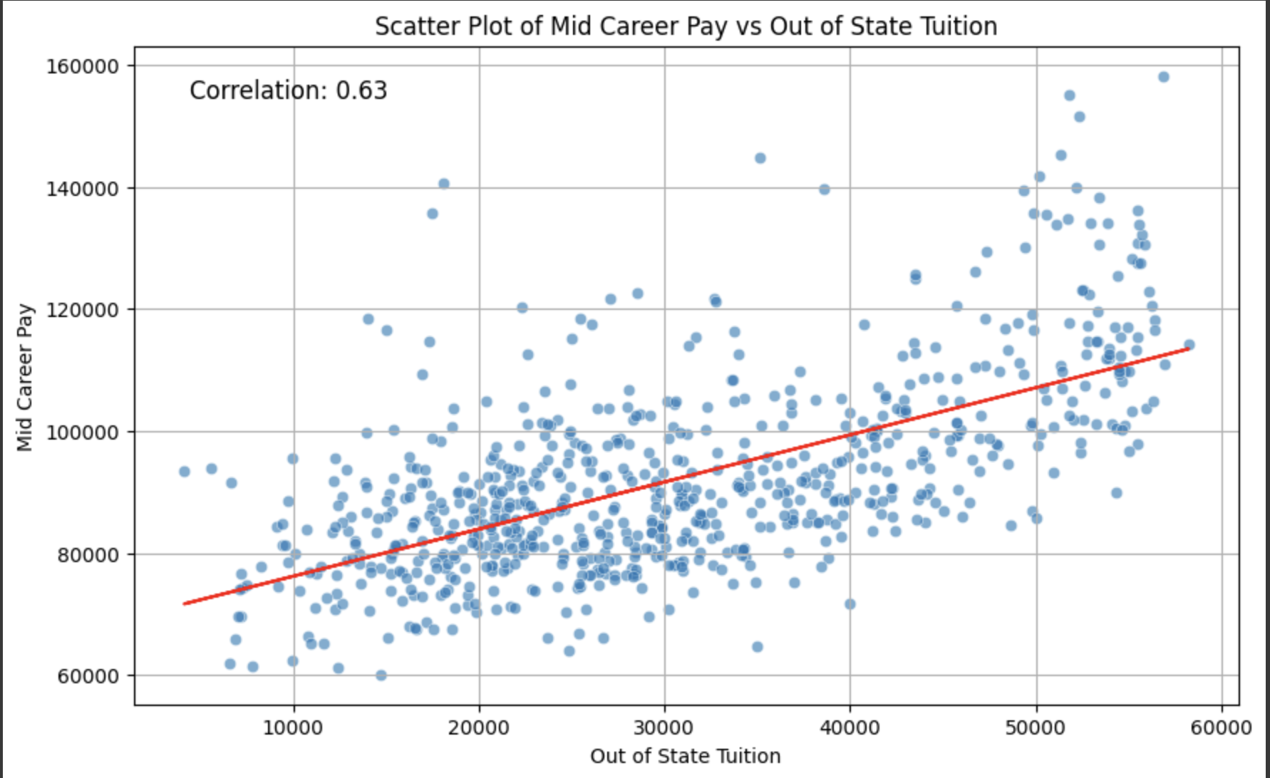
Higher tuition usually means higher post-grad pay
So, maybe we should not discount schools just because they have high tuitions, especially if aid is obtainable
Slope: 0.7723124056215699
R-squared: 0.4019724702493942
Notes:
Could be useful if people are really wary of applying high tuition because your post-grad salary which you will be making over more than just 4 years may be much higher than a lower tuition university
Also as we saw before, net cost may be better to look at because, for instance, even though Stanford and Harvard have really high tuitions, they actually pay the lowest income bracket to attend, and then they can reap high benefits.

Slide 9
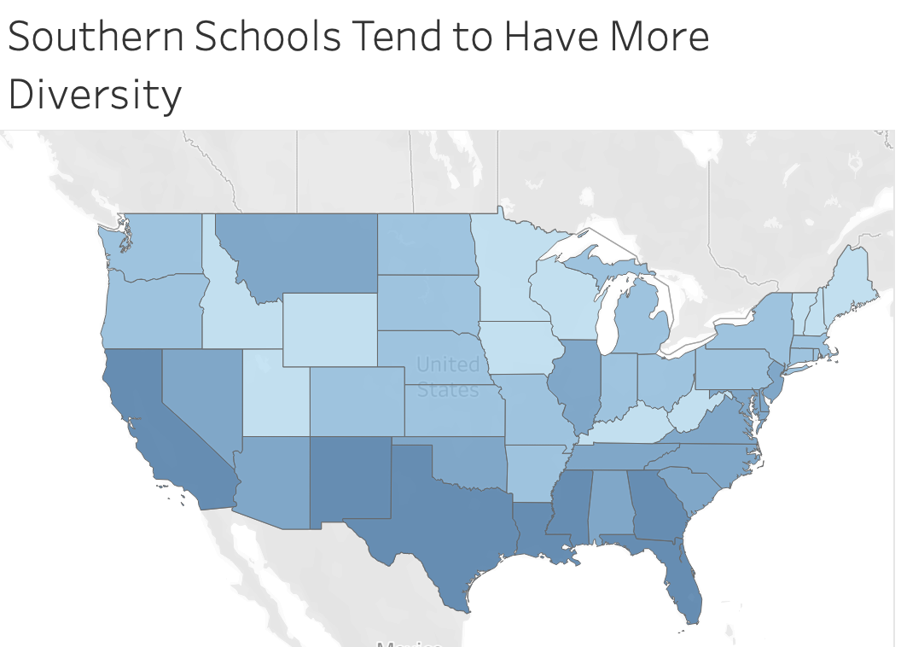
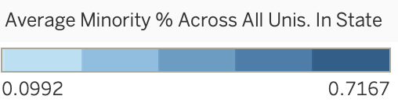


22%
71%
55%
Notes:
One of the criteria for one my best friends out of high school in Minnesota was seeking more diversity, especially as someone of Asian and Latino descent. He ended up going to UCLA partially due to this. This visualization and insight can be informative to students who are seeking diversity.

Slide 10
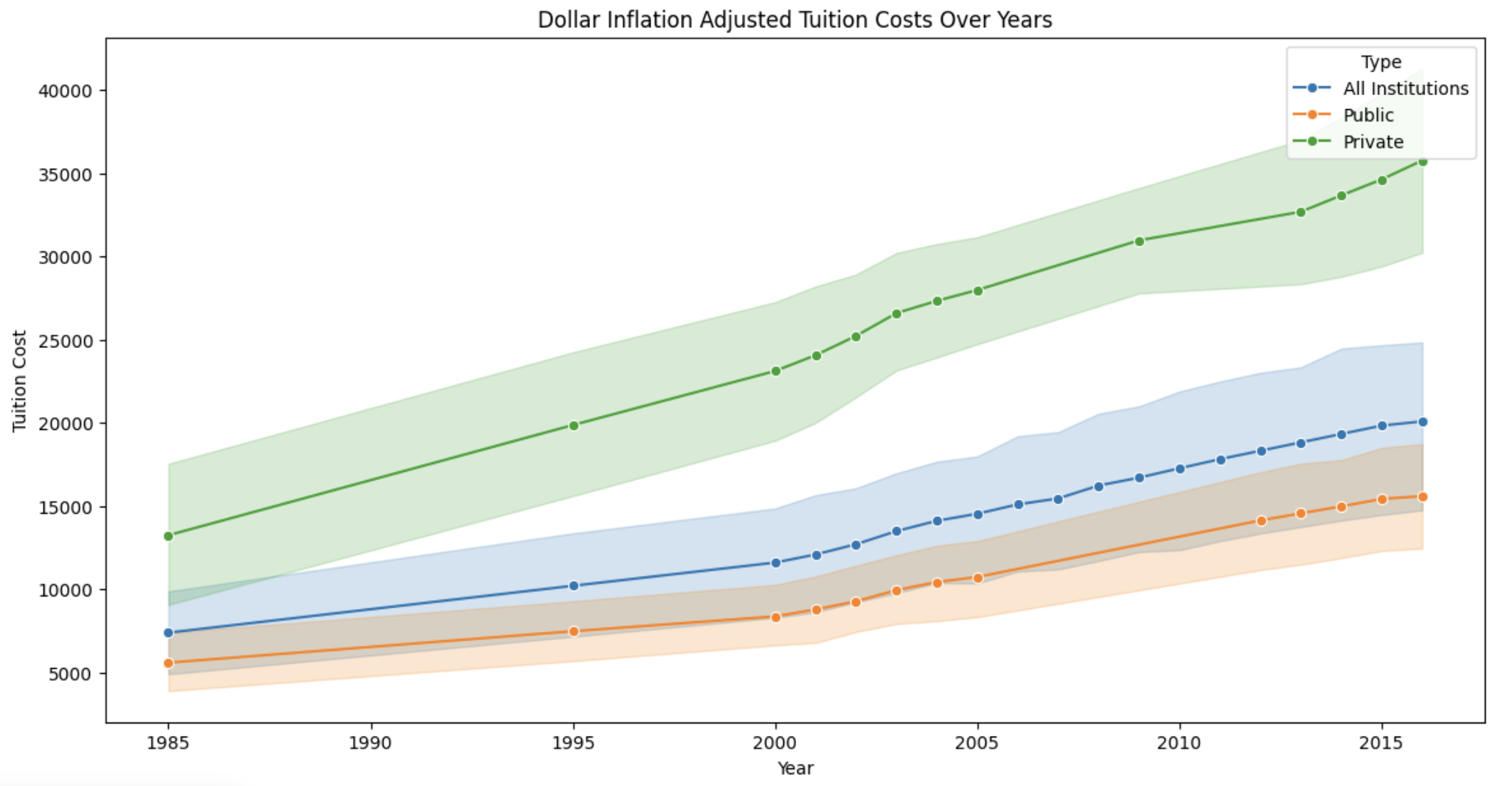
Dollar inflation adjusted tuition is rising across all institutions: Financial aid seems more crucial than ever
Notes:
#this could be interesting to look into more. it seems financial aid is crucial more than ever. maybe quality and services in education are improving. also would be key to see if this is disproportionately affecting lower income levels.

Slide 11
ANY QUESTIONS?

Slide 12
Appendix: Not Too Much Data Prep Needed
Main Data Prep:
Merges
0s instead of NAs
Mainly took care of this by dropping colleges that had net cost of 0 for highest income level
Historic Tuition Year format: “2011-2012”
NAs in Make World A Better Place % & Room and Board
Lots of filtering

Slide 13
Appendix to Slide 15
Net Cost is probably more important to look at than tuition when considering cost (and why I used that in my value calculation)
Net Cost = average actually paid after scholarship/award
Example:
Stanford tuition in 2015: $51,354
Stanford net cost for low income in 2015: $1,630

Slide 14
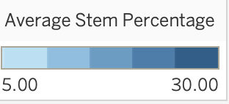
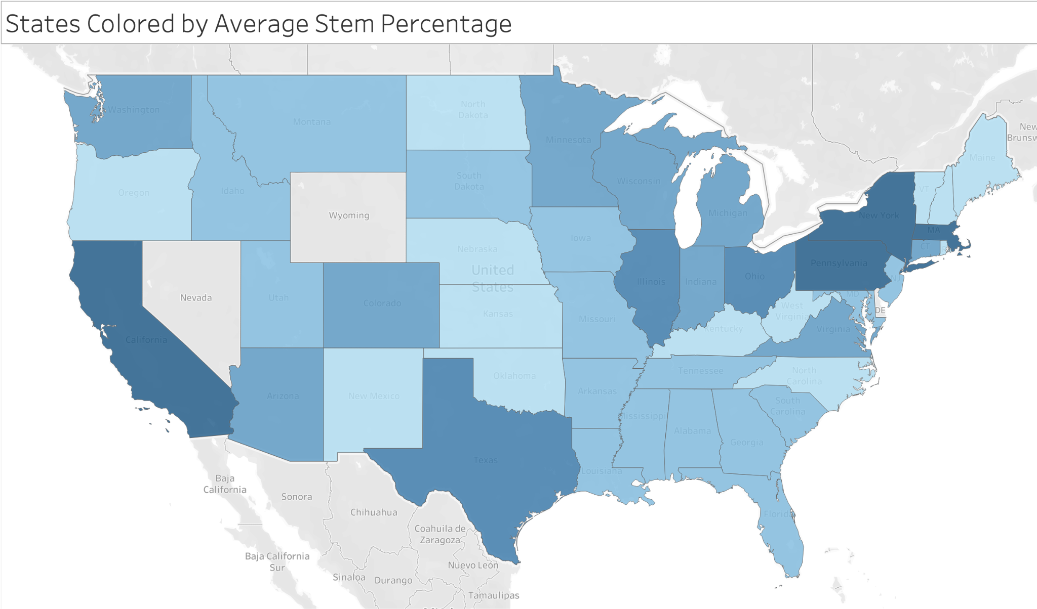

Appendix: States Colored by Median STEM Percentage
25%
30%
27%
29.5%

Slide 15
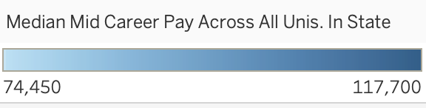

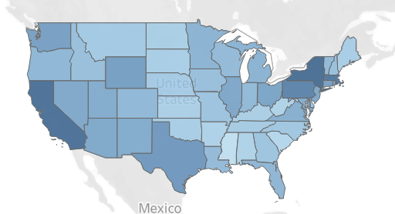

Appendix: California universities tend to produce graduates with higher mid-career salaries than Mississippi universities
$117,700
$74,450

